Slide 1
Tests & Operations on fragments
Tutorial

Slide 2
Types of Tests or Operations:
Scissor Test
Multisample Fragment Operations
Stencil Test
Depth test
Blending

Slide 3
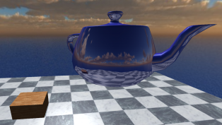
Scissor Test

Slide 4

Scissor Test
glScissor(x, y, width, height)
(x, y)

Slide 5
Multisample Fragment Operations
Calculates alpha independent fragment coverage values.
Special modes to consider alpha values
GL_SAMPLE_ALPHA_TO_COVERAGE (use alpha value of fragment for final coverage value)
GL_SAMPLE_ALPHA_TO_ONE (set fragment’s alpha value to max and used further max value further)
GL_SAMPLE_COVERAGE (use value set with glSampleCoverage() routine)
GL_SAMPLE_MASK (each sample in framebuffer is ANDed with sample coverage for the fragment)

Slide 6
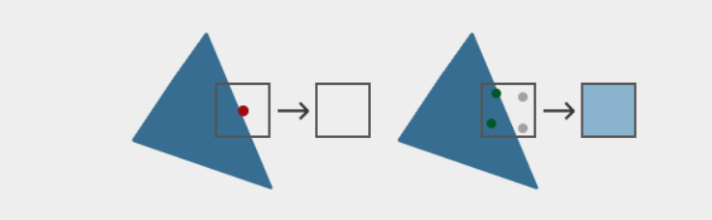
Multisampling Anti Aliasing
No fragment Shader
Multisampled
Version
Fragment shader is only run once per pixel (for each primitive)
Uses a larger depth/stencil buffer to determine subsample coverage
For depth testing the vertex's depth value is interpolated to each subsample
For stencil testing, the stencil values per subsample are stored
The triangle's color is mixed with the framebuffer color for each subsample

Slide 7
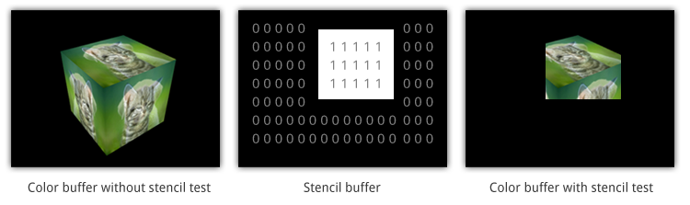
Stencil Test
Test takes place only if there is stencil buffer
Compares a reference value with the value stored at a pixel in stencil buffer

Slide 8
Stencil Test
Steps in stencil test:
Enable writing to the stencil buffer
Update the stencil buffer value while rendering the objects
Disable writing to the stencil buffer
Compare the reference value with stencil buffer value, and render the objects

Slide 9
Stencil Test
Important notes for stencil test:
glEnable(GL_STENCIL_TEST); //to enable the stencil test
glClear(GL_COLOR_BUFFER_BIT | GL_STENCIL_BUFFER_BIT); //to clear stencil buffer after each iteration just like color buffer
glStencilMask(0xFF); // each bit is written to the stencil buffer as is glStencilMask(0x00); // each bit ends up as 0 in the stencil buffer (disabling writes)
glStencilFunc(GL_EQUAL, 1, 0xFF) //used to control if test pass or fail

Slide 10


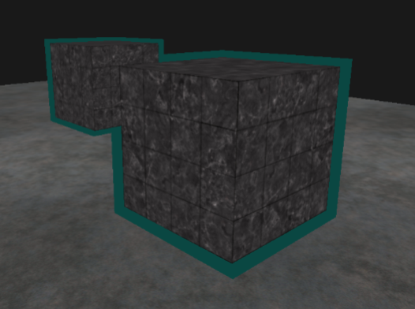
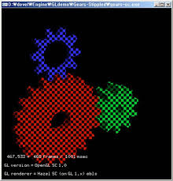
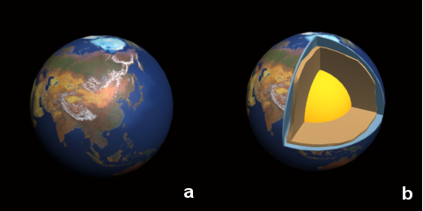
Stencil Test Applications
Outlining
Capping
Stippling

Slide 11
Depth test
Depth Test
Fragment discarded
Fragment rendered
Depth buffer updated

Slide 12
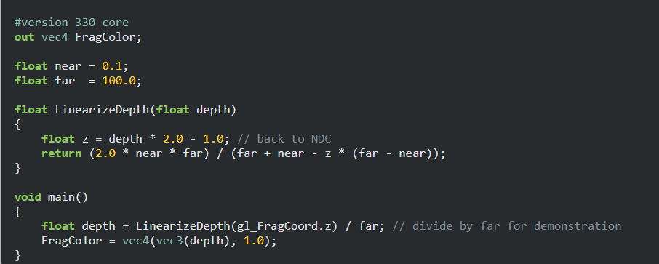
Depth test

Slide 13
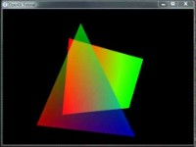
Blending

Slide 14
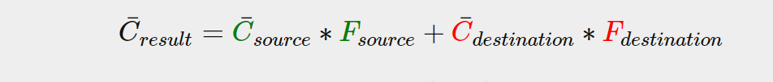
Blending
Used for rendering semi transparent objects.
Resulting vector
Source Color vector
Source Factor vector (alpha impact)
Destination Color Vector
Destination Factor Vector (alpha impact)

Slide 15
Blending
glBlendFunc(GL_SRC_ALPHA, GL_ONE_MINUS_SRC_ALPHA);
glBlendFuncSeparate(GL_SRC_ALPHA, GL_ONE_MINUS_SRC_ALPHA, GL_ONE, GL_ZERO);
With multiple transparent and non-transparent objects:
Draw all opaque objects first.
Sort all the transparent objects.
Draw all the transparent objects in sorted order.

Slide 16
THANK YOU!

